Slide 1
Module-1: Foundations of Penetration Testing and Cybersecurity

Slide 2

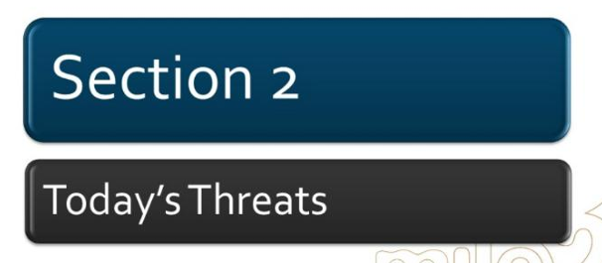
Class 02

Slide 3

Today’s Threats – Simple List:
🔴 Critical Threats
Ransomware-as-a-Service (RaaS)
Phishing & Business Email Compromise (BEC)
Advanced Persistent Threats (APT)
🟠 High Threats
AI-Powered Cyber Attacks (Deepfake, AI phishing)
Zero-Day Exploits & Vulnerability Attacks
Credential Theft & Account Takeover

Slide 4
Today’s Threats – Simple List:
🔵 Emerging Threats
Cloud Security Misconfigurations
API Attacks & Web Application Exploits
IoT & OT (Industrial) Attacks

Slide 5
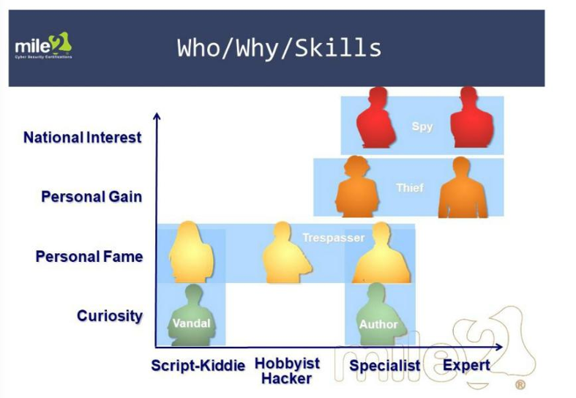


Slide 6
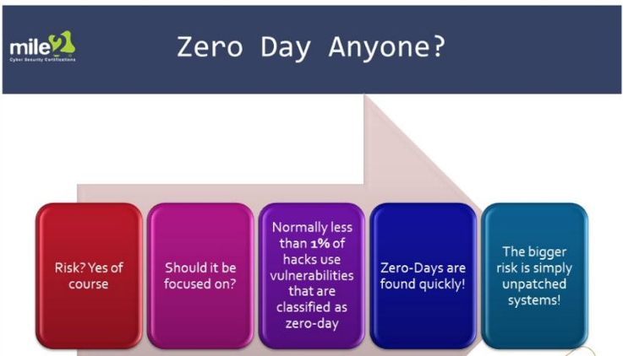

Slide 7
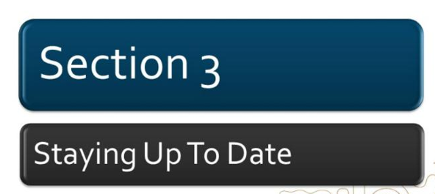

Slide 8
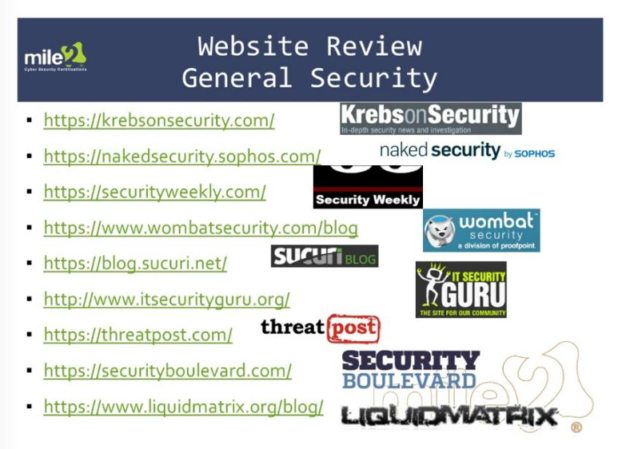


Slide 9
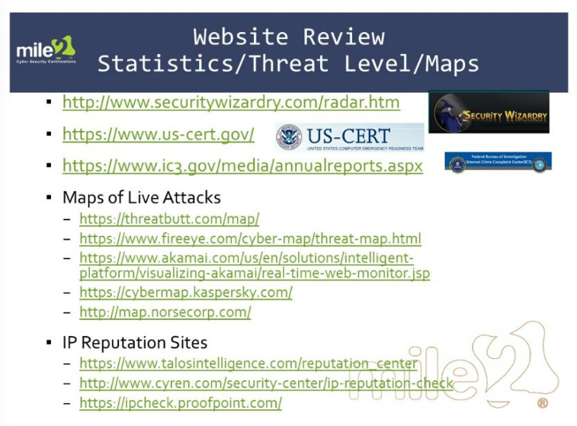

Slide 10
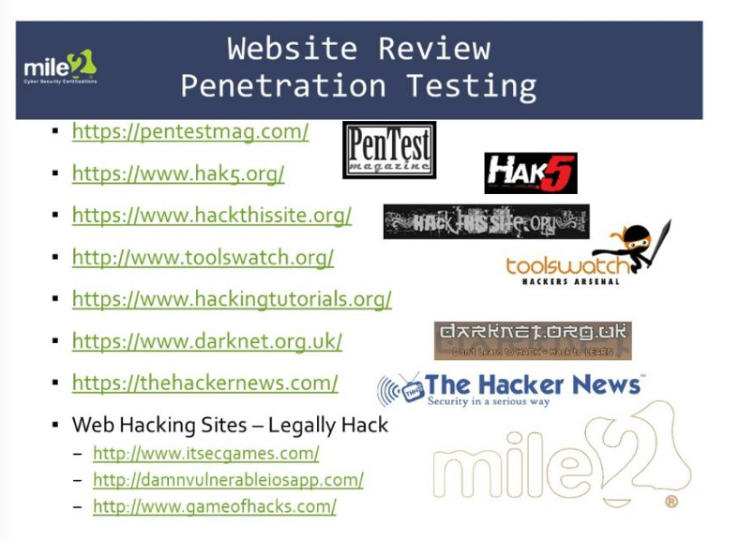

Slide 11
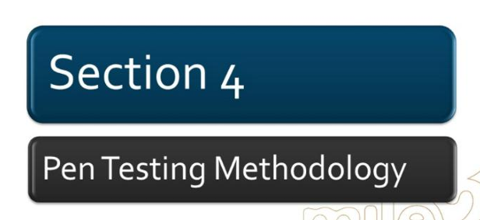

Slide 12
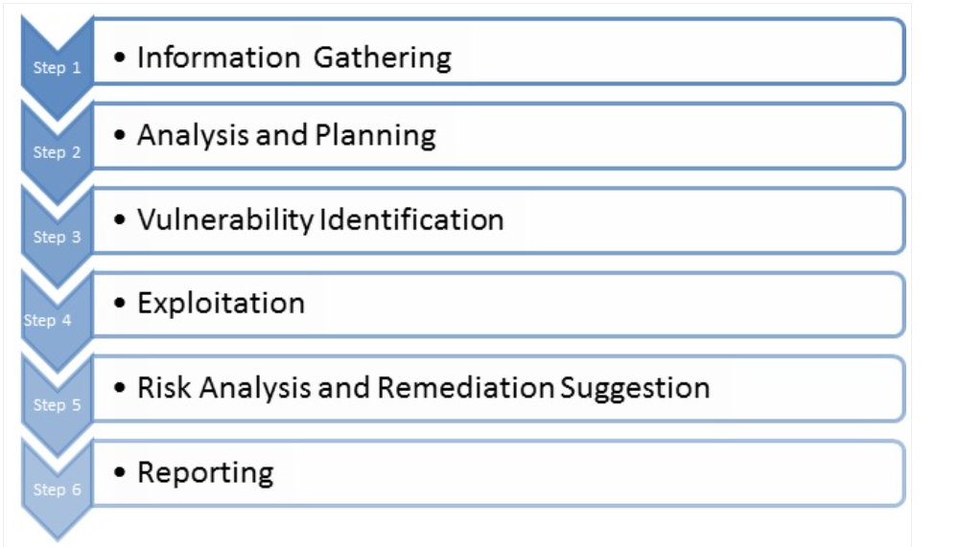

Slide 13
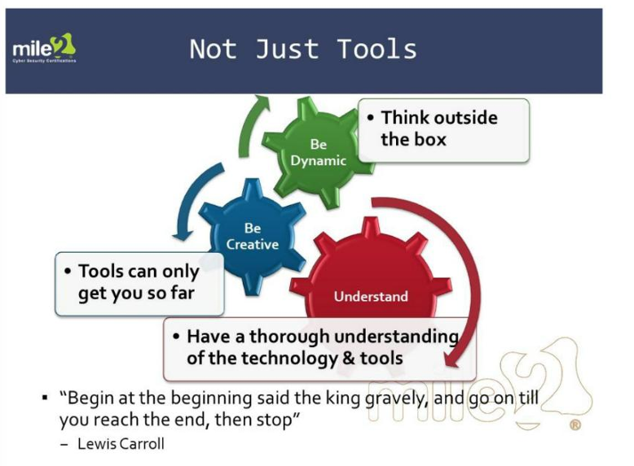

Slide 14
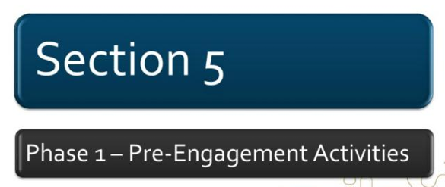

Slide 15
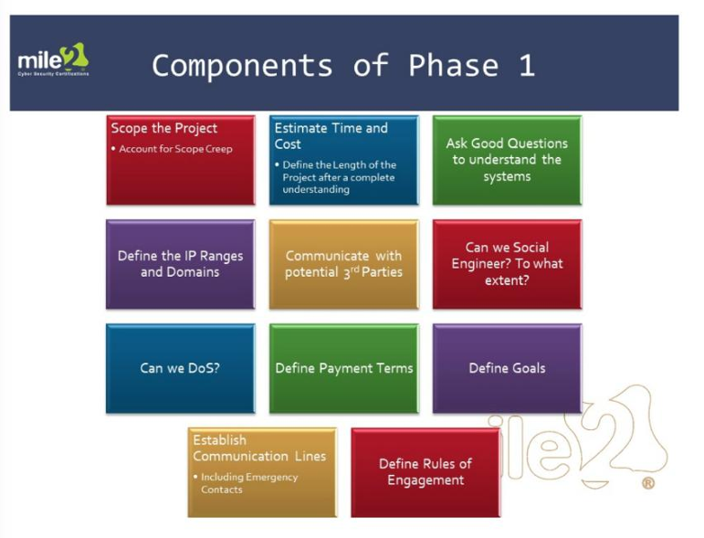

Slide 16
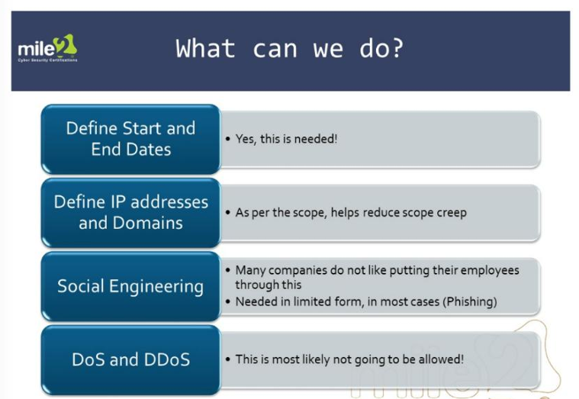

Slide 17
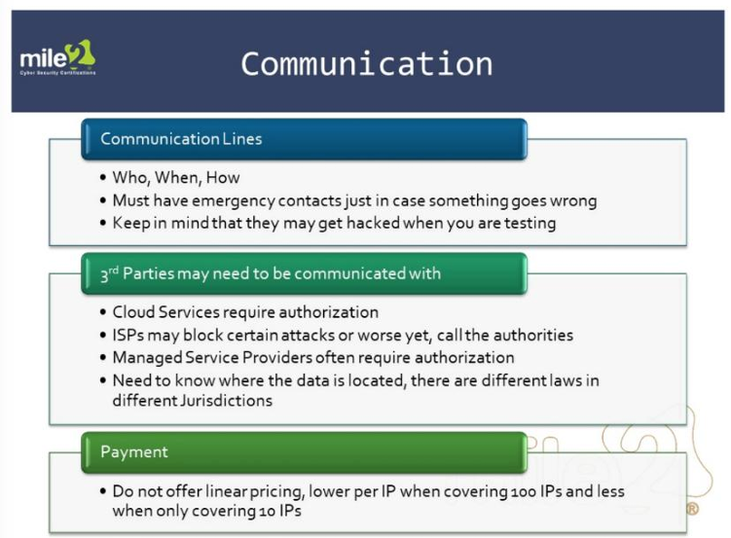

Slide 18
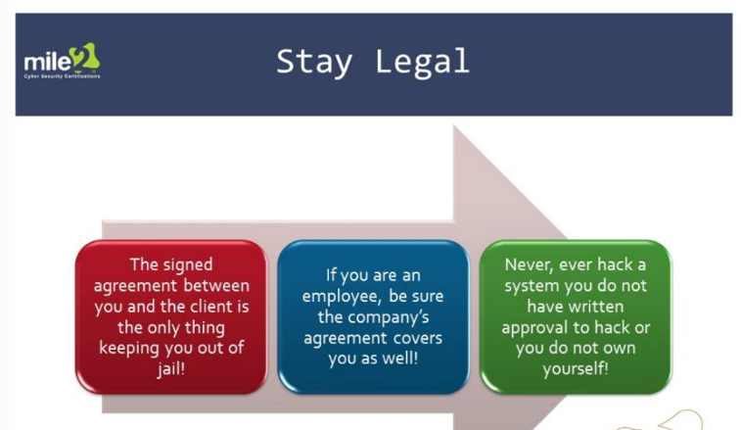

Slide 19
